Slide 1
RADAR ON ROADS
PIP2001 Capstone Project
Review-1
Batch Number: CCS-G28
Roll Number | Student Name
20211CCS0017 | M Sonali
20211CCS0026 | Bhavana MM
20211CCS0034 | Jakku Nishithaa
20211CCS0153 | Hiranmayi R
Under the Supervision of,
Dr. Nagaraj SR
Professor / Associate Professor / Assistant Professor
School of Computer Science and Engineering
Presidency University
Name of the Program: Computer Science and Engineering Spl. Cyber Security
Name of the HoD: Dr. S P Anandaraj
Name of the Program Project Coordinator: Dr. Sharmast Vali Y
Name of the School Project Coordinators: Dr. Sampath A K / Dr. Abdul Khadar A / Mr. Md Ziaur Rahman

Slide 2
Introduction
In many cities there is a substantial traffic jam at toll booths, particularly on weekends. Even after NHAI introduced FASTag RFID stickers, the problem has not been entirely resolved by the system. The FASTag system is either completely non-functional or only partially functioning in several places. Insufficiencies result from the necessity for vehicles to slow down in order for sensors to recognize the sticker and deduct the amount. To enhance the procedure. So, Radar on Roads suggests a system that will be helpful to manage traffic and time for people. In this system we use GPS and GSM Module.

Slide 3
Literature Review
Author Name. | Research Paper Name. | Published date and Platform. | Challenges. | Solutions.
Ni Ni San Hlaing, Ma Naing, San San Naing | GPS and GSM Based Vehicle Tracking System, Volume: 3 | Issue: 4 | | May-Jun 2019, International Journal of Trend in Scientific Research and Development (IJTSRD) | Implementation of proper network and satellite connection. | Have the GSM Module properly installed in the particular toll booth.
Goutham K, Gowtham M, Megalan Leo.L. | GPS Based E-Toll Gate collection System. | 26 June 2023, ©2023 IEEE | DOI: 10.1109/VITECON58111.2023.10157947 | Connecting to proper interface. | Reduced traffic and toll fare.
G. Nowacki, I. Mitraszeweska, Tomasz Marcin Kaminski. | GSM/GPS based toll collection system – proposal for Poland | June 2009, ResearchGate. | Understanding toll system of Germany and other European countries. | Understanding the proper usage of toll booths and implementing them in Poland.
V. Sathya, Abdul Samath | Automatic Toll Collection Centre (ATCC) using GSM/GPS Proposal for Indian Toll Booths. | Jul 15, 2013, Asdf Journals. | Network coverage, Infrastructure upgrade And Public acceptance | Increasing public awareness, Network coverage: Ensuring reliable GSM and GPS coverage.
Rajeev Kumar Chauhan, Kalpana Chauhan. | Intelligent toll collection system for moving vehicles in India. | 6 September 2021, Science Direct. | Implementing electronic toll collection systems and High operational costs. | Implementing a satellite-based toll collection system
Saddam. | Arduino Based Vehicle Tracker Using GPS and GSM. | March 03, 2016, Circuit Digest. | Power consumption and Environmental factors | Implementing a low-power mode
Firas Muhammad Zeki Mahmood. | Vehicle Tracking System by Using GPS, GSM, and Arduino Technology. | January 2022, ResearchGate. | GPS signal loss and User interface | Developing a user-friendly interface and Using a high-gain GPS antenna
Dr. Khali Persad, Dr. C. Michael Walton, Shahriyar Hussain. | Toll Collection Technology and Best Practices, Project 0┽5217: Vehicle/License Plate Identification For Toll Collection Applications. | January 2007, TRID Database. | Variable Lighting Conditions and High Volume of Data | Weatherproof Equipment and Cloud-Based Solutions
Anandaraj S, Mohana Arasi M. | Intelligent Toll Path System Using GPS and GSM, Vol. 5, Issue 5. | May 2016, International Journal of Advanced Research in Computer and Communication Engineering | GPS Signal Interference | GPS Signal and GSM Network Optimization
Mrs. K.P.Kamble. | SMART VEHICLE TRACKING SYSTEM, Vol.3, No.4. | July 2012, ResearchGate. | Location Inaccuracy and Maintenance | Cellular Network-Based Tracking and Maintenance Scheduling:

Slide 4
Existing method Drawback
Too much of vehicle pile-up in toll booths.
Air pollution.
Paying same amount of money irrespective of distance travelled.
Fuel consumption.
Insufficient payment methods.
Increase in travel time.
Operational insufficiencies.
Technological gap.
Maintenance cost.
Difficulty for emergency vehicle.
Impact on long distance travel.

Slide 5
Proposed Method
The proposed method for Radar on Roads is that instead of using RFID tags, we’re using GPS and GSM module. When a vehicle passes through a toll plaza the GPS system and GSM Module in the vehicle gets coordinated with the GSM Module of that particular toll plaza, the driver also gets intimated that they’ve crossed this particular toll plaza. As the driver keeps driving they get intimated every ten kilometres. The complete amount only gets deducted if the driver has utilized the entire highway, if the driver takes a diversion or uses the service road the amount gets deducted according to that. We’re using Haversine formula to calculate the distance travelled from one point to another.

Slide 6
Objectives
Our objective for this project is:
Reduced toll fare.
Reduced traffic.
Makes sure that the driver is well aware of the distance covered.
Making sure that there is less air pollution.
Making sure that the travel time effected.
Reducing fuel consumption.
Emergency vehicles can go without any issues.

Slide 7
Methodology/Modules
Haversine Formula is a mathematical formula used to calculate the distance between two points on a sphere, such as the Earth, using their latitude and longitude coordinates.
Vehicle Detection and Identification: GPS system.
Payment Methods: Prepaid systems and mobile payment apps.
Data processing and toll processing: ESP 32 is used as a server to calculate the fare.
User Interface(UI): LCD Display, Speaker and Amplifier and buttons.

Slide 8
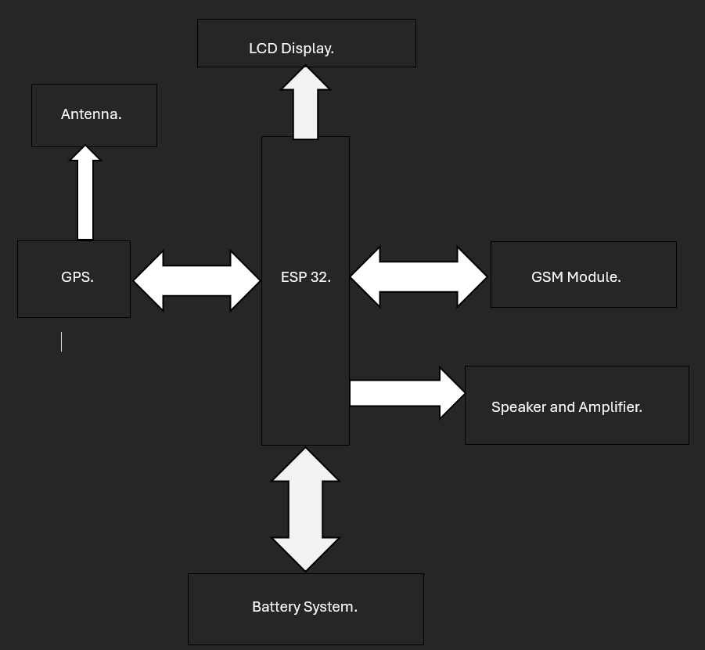
Architecture

Slide 9
Hardware components.
GPS Module:
NEO-6M GPS module for real-time vehicle tracking and distance calculation.
GSM Module:
SIM800C GSM module for communication with the central server, sending toll data, and receiving fare updates.
LCD Display:
JHD 204A (20x4) LCD for displaying GPS coordinates, distance traveled, and fare information in real-time.
Speaker and Amplifier:
PAM8403 amplifier module paired with a speaker to provide audible notifications, such as fare updates and toll entry/exit alerts.
Microcontroller:
ESP32 for managing GPS, GSM, LCD, and speaker, handling fare calculations, and enabling wireless communication with IoT systems.
Battery System:
18650 Li-ion batteries with HX-4S-A20 board for powering the system independently from external power sources.

Slide 10
Software components.
Manages GPS tracking, toll calculation, and communication with the backend system.
Firmware for GPS and GSM Modules:
Handles GPS data collection and real-time location tracking using the NEO-6M GPS module, as well as sending toll data and fare updates via the SIM800C GSM module.
Fare Calculation Logic:
Implements algorithms for calculating tolls based on the distance traveled, updating every 10 km, and communicating the fare to the display and speaker.
Data Management Software:
Integrates with the backend system for recording vehicle entry/exit, updating toll charges, and sending notifications to the central server.
IoT Communication Protocols:
Ensures real-time communication between the ESP32, GPS, GSM modules, and the backend toll system for data transmission and notifications.

Slide 11
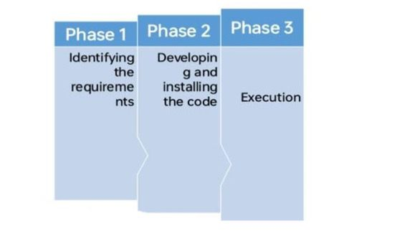
Timeline of Project

Slide 12
Expected Outcomes
The expected outcomes are:
Reduced or no traffic at toll plaza.
Money deduction according to the distance travelled in the highway.
Reduced air pollution.
Reduced noise pollution.
Reduced travel time.
Travel record
Eliminates the traditional toll systems

Slide 13
Conclusion
As we conclude this project:
Radar on Roads will be able to ease travellers experience when they travel on highways. The integration of radar technology in toll collection systems enhances efficiency, accuracy, and safety by enabling reliable vehicle detection, speed measurement, and classification, while also improving traffic management.
As radar technology evolves, it promises to further innovate toll collection processes, reducing congestion and ensuring fair toll charges.
It minimizes manual intervention and reduces traffic congestion at toll booths.
It improves overall road efficiency.
The use of secure payment method, real time identification ensures both accuracy in toll calculations and privacy for users.

Slide 14
Github Link
https://github.com/hiranshree/Radar-on-Roads.git

Slide 15
References
Ni Ni San Hlaing1, Ma Naing2, San San Naing1. GPS and GSM Based Vehicle Tracking System, Volume: 3 | Issue: 4 | May-Jun 2019.
Goutham K, Gowtham M, Megalan Leo.L. GPS Based E-Toll Gate collection System, 26 June 2023.
G. Nowacki, I. Mitraszeweska, Tomasz Marcin Kaminski. GSM/GPS based toll collection system – proposal for Poland. June 2009
V. Sathya, Abdul Samath. Automatic Toll Collection Centre (ATCC) using GSM/GPS Proposal for Indian Toll Booths. Jul 15, 2013
Rajeev Kumar Chauhan, Kalpana Chauhan. Intelligent toll collection system for moving vehicles in India, 6 September 2021
Saddam, Arduino Based Vehicle Tracker Using GPS and GSM, March 03, 2016.

Slide 16
References
Firas Muhammad Zeki Mahmood, Vehicle Tracking System by Using GPS, GSM, and Arduino Technology, January 2022.
Dr. Khali Persad, Dr. C. Michael Walton, Shahriyar Hussain, Toll Collection Technology and Best Practices, Project 0┽5217: Vehicle/License Plate Identification For Toll Collection Applications, January 2007.
Anandaraj S, Mohana Arasi M, Intelligent Toll Path System Using GPS and GSM, Vol. 5, Issue 5, May 2016.
Mrs. K.P.Kamble, SMART VEHICLE TRACKING SYSTEM, Vol.3, No.4, July 2012.

Slide 17

Project work mapping with SDG
SDG 8. Decent work and Economic Growth.
SDG 9. Industry Innovation and Infrastructure.
SDG 10. Reduced Inequalities.
SDG 12. Responsible consumption and production.
SDG 17. Partnership for the goals.

Slide 18
Thank You

